Slide 1
Object-Oriented Analysis and Design using JAVA
B.Tech (CSE/IT) 5th SEM
2022-2023
Lecture-14 Introduction to UML

Slide 2
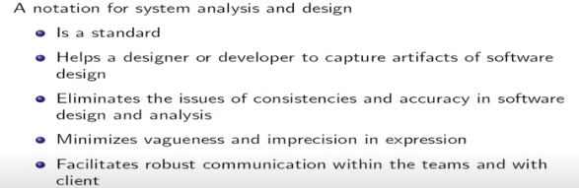
Why is UML?
Reference: UML and the Unified Process Practical object-oriented analysis and design-By-Jim Arlow , Neustadt

Slide 3
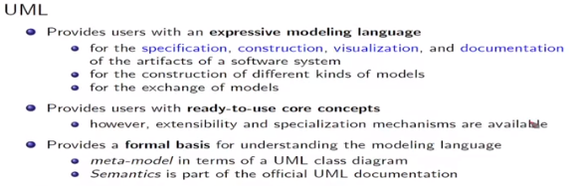

What is UML?

Slide 4
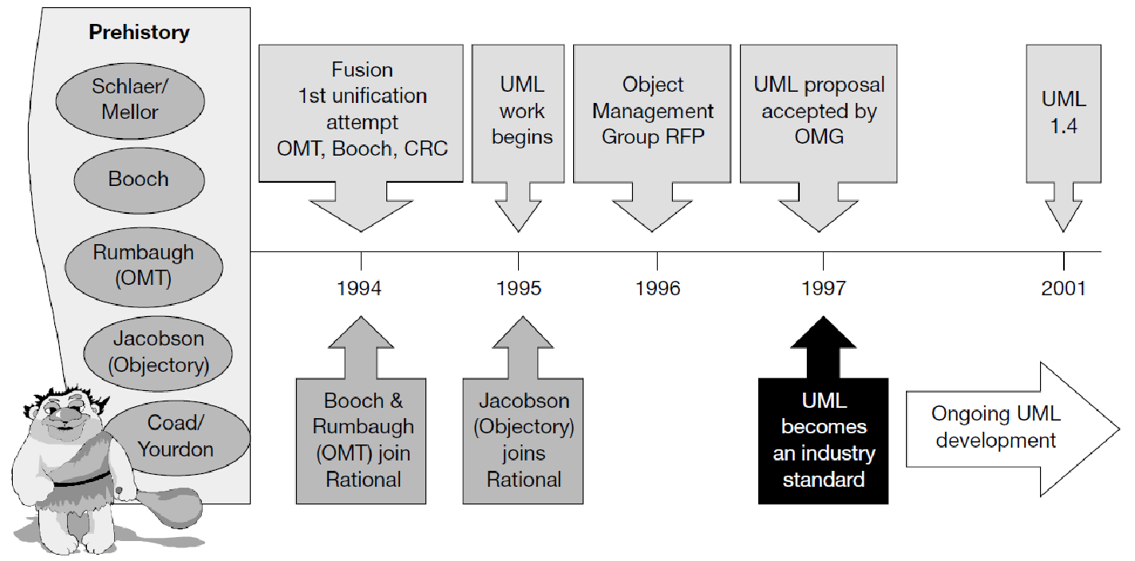
The birth of UML
Reference: UML and the Unified Process Practical object-oriented analysis and design-By-Jim Arlow , Neustadt

Slide 5
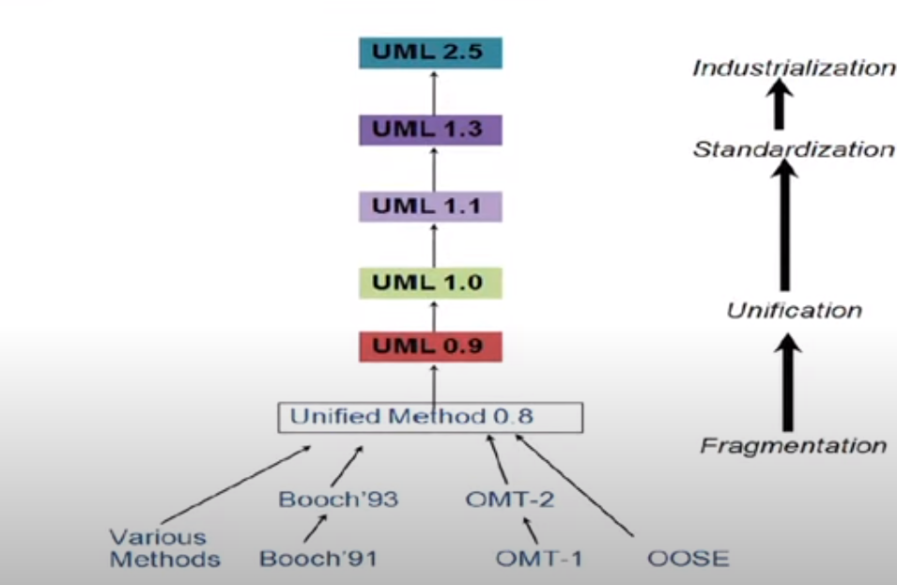
How UML was formed?

Slide 6
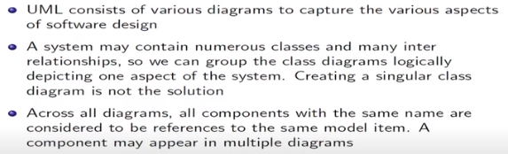
Concept of Diagram

Slide 7
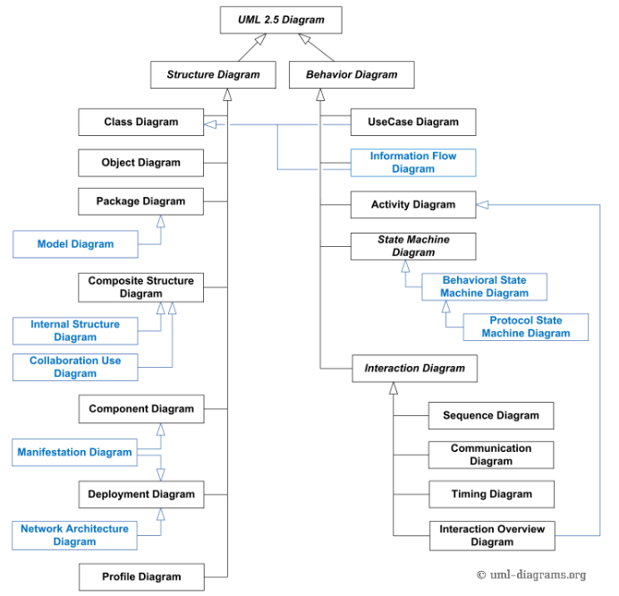
Diagram Classification

Slide 8
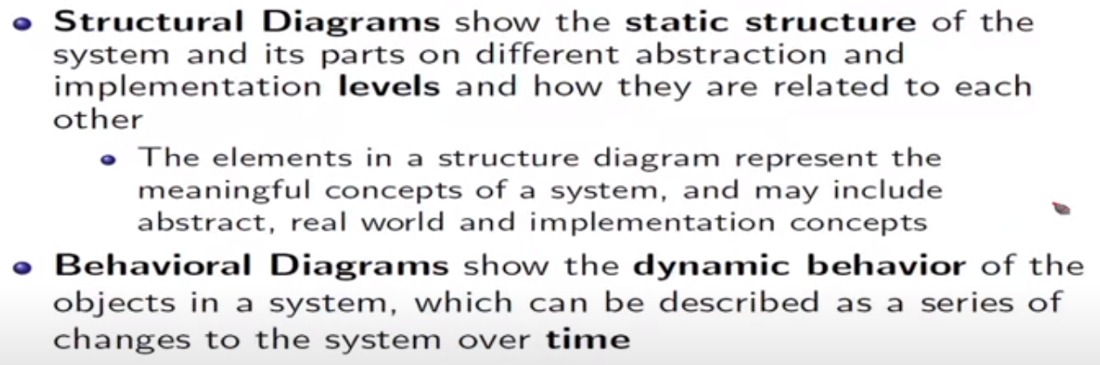
Diagram Classification

Slide 9
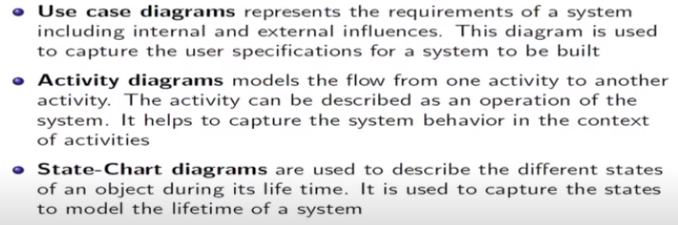
Behavioural Diagrams

Slide 10
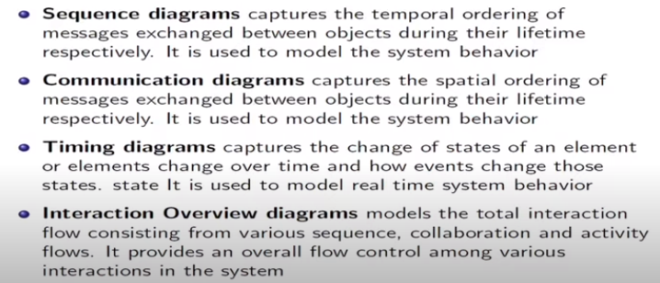
Behavioural Diagrams: Interaction Diagrams

Slide 11
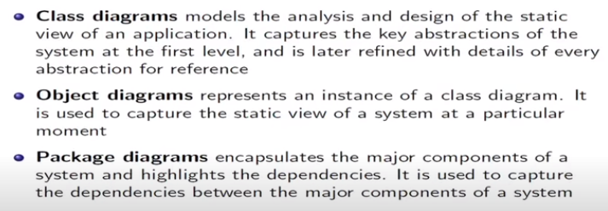
Structural Diagrams

